Slide 1
Lead scoring case study
Submitted by
Nasheetha K Moithu

Slide 2
Agenda
The purpose is to optimize the lead scoring mechanism based on their it,graphics,behaviors,buying tendency etc.By implementing explicit and implicit lead scoring modelling with lead point system.

Slide 3
Problem statement
An education company named X Education sells online courses to industry professionals. On any given day, many professionals who are interested in the courses land on their website and browse for courses.
The company markets its courses on several websites and search engines like Google. Once these people land on the website, they might browse the courses or fill up a form for the course or watch some videos. When these people fill up a form providing their email address or phone number, they are classified to be a lead. Moreover, the company also gets leads through past referrals. Once these leads are acquired, employees from the sales team start making calls, writing emails, etc. Through this process, some of the leads get converted while most do not. The typical lead conversion rate at X education is around 30%.
Now, although X Education gets a lot of leads, its lead conversion rate is very poor. For example, if, say, they acquire 100 leads in a day, only about 30 of them are converted. To make this process more efficient, the company wishes to identify the most potential leads, also known as ‘Hot Leads’. If they successfully identify this set of leads, the lead conversion rate should go up as the sales team will now be focusing more on communicating with the potential leads rather than making calls to everyone.

Slide 4
Approach
Source the data for analysis
Reading & understanding the data
Data cleaning
EDA
Feature Scaling
Splitting the data into test & train dataset
Prepare the data for modelling
Model building
Model evaluation-specificity &sensitivity or precision recall
Making predictions on the test set

Slide 5
Data sourcing, cleaning & preparation
Read the data from csv file
Outlier treatment
Data cleaning – handling null values& removing higher null values data
Removing redundant columns in the data
Imputing Null values
Exploratory data analysis-approx. Conversion Rate is 38%
Feature standardization

Slide 6
Goals of the Case Study
There are quite a few goals for this case study:
Build a logistic regression model to assign a lead score between 0 and 100 to each of the leads which can be used by the company to target potential leads. A higher score would mean that the lead is hot, i.e. is most likely to convert whereas a lower score would mean that the lead is cold and will mostly not get converted.
There are some more problems presented by the company which your model should be able to adjust to if the company's requirement changes in the future so you will need to handle these as well.

Slide 7
Variables Impacting the Conversion Rate
Do Not Email
Total Visits
Total Time Spent On Website
Lead Origin – Lead Page Submission
Lead Origin – Lead Add Form
Lead Source - Olark Chat
Last Source – Welingak Website
Last Activity – Email Bounced
Last Activity – Not Sure
Last Activity – Olark Chat Conversation
Last Activity – SMS Sent
Current Occupation – No Information
Current Occupation – Working Professional
Last Notable Activity – Had a Phone Conversation
Last Notable Activity - Unreachable Model Evaluation - Sensitivity and

Slide 8
Data Preparation
Converted binary variables to 0 & 1
Created dummy variables for categorical variables

Slide 9
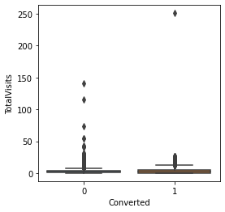
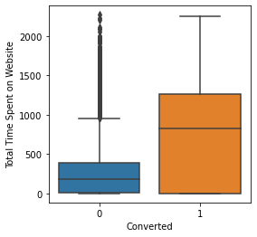
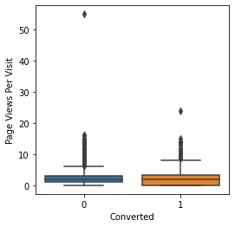
Outliers: Total visits, total time spent on websites,page views per visit have outliers

Slide 10
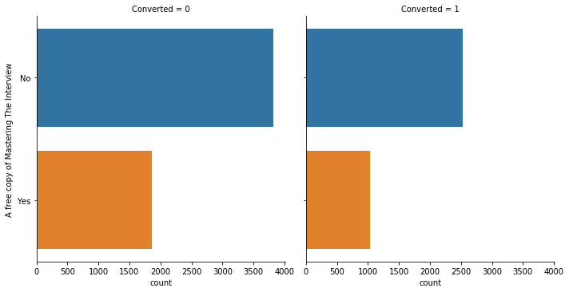
EDA plots depicting variation in categorical column (A free copy of Mastering The Interview) for those who Converted and those who didn't.

Slide 11
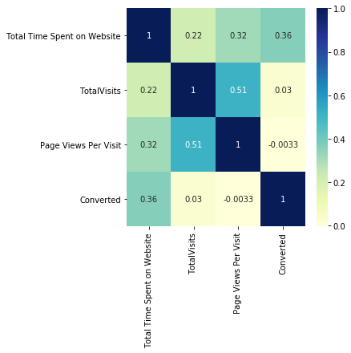
EDA plots depicting correlation (Heat Map) of all selected numerical columns.

Slide 12
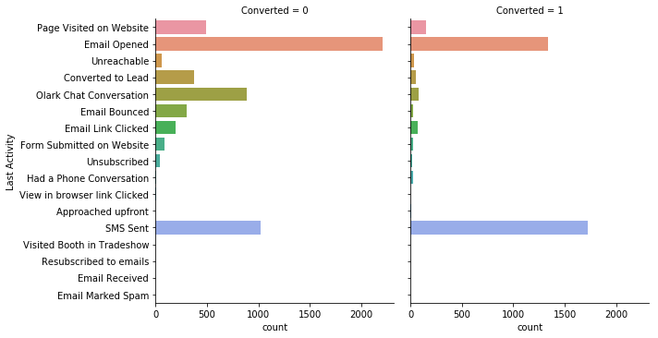
EDA plots depicting variation in categorical column (Last Activity) for those who Converted and those who didn't.

Slide 13
EDA plots depicting variation in categorical column (A free copy of Mastering The Interview) for those who Converted and those who didn't.

Slide 14
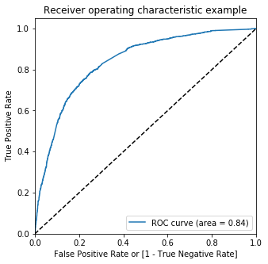
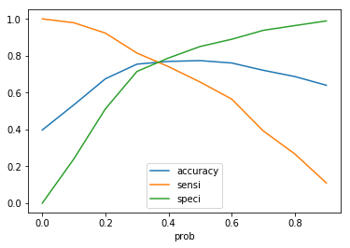
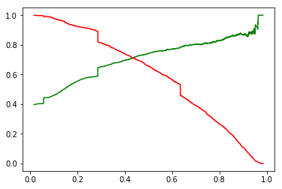
Linear Regression Final Model Parameters Area under ROC = 0.84 Intermediate cut-off = 0.35 Final cut-off = 0.42

Slide 15
Conclusion
While we have checked both Sensitivity-Specificity as well as Precision and Recall Metrics, we have considered the optimal cut off based on Sensitivity and Specificity for calculating the final prediction.
Accuracy, Sensitivity and Specificity values of test set are around 81%, 79% and 82% which are approximately closer to the respective values calculated using trained set.
Also the lead score calculated shows the conversion rate on the final predicted model is around 80% (in train set) and 79% in test set
The top 3 variables that contribute for lead getting converted in the model are 1) Total time spent on website 2)Lead Add Form from Lead Origin 3) Had a Phone Conversation from Last Notable Activity
Hence overall this model seems to be good

